Slide 1
PM2.5 Data Analysis and Forecasting Using AI

Slide 2
Research
This project aimed to refine PM2.5 air quality forecasting in Philadelphia, tackling the issue of local variability that broad-scale models often miss. An ensemble approach was employed, blending advanced spatio-temporal data analysis with specific local insights early in the development of machine learning (ML) models. Techniques such as the Kolmogorov-Zurbenko filter, HYSPLIT model, pollution roses, and conditional probability functions provide a nuanced understanding of the area's air quality dynamics. This understanding was incorporated at the outset of the training process to supervise the ML model, utilizing Random Forest, Artificial Neural Networks, and Gradient Boosting. Implemented across 25 monitoring sites from 2019-2023, our method aimed to enhance prediction accuracy by adapting the models to Philadelphia's unique environmental context. Renowned researchers such as Armistead Russell have previously aimed to perform PM2.5 sensitivity analyses prior to forecasting model creation. A similar early supervision technique was utilized in the conduction of this experiment. The project underscores the effectiveness of integrating detailed local data analyses with ML for more precise environmental data science and air quality forecasting.

Slide 3
Hypothesis
Hypothesis 1:
Integrating Philadelphia-specific air quality data and advanced data analysis into ML model development will improve PM2.5 forecasting accuracy.
Hypothesis 2:
Ensemble models combining local environmental data with machine learning—selecting the top performer from Random Forest, ANN, and Gradient Boosting—will more accurately predict PM2.5 variabilities in Philadelphia than traditional approaches.

Slide 4
Question
For Hypothesis 1:
Effectiveness: How does incorporating Philadelphia-specific air quality data and advanced spatio-temporal analysis into the early supervision phase of ML models influence the predictive accuracy for PM2.5 levels?
Validation: Which validation methods are most effective in demonstrating the accuracy improvements of PM2.5 forecasts when using Philadelphia-specific data and advanced analysis in ML models?
For Hypothesis 2:
Effectiveness: How does the ensemble approach, integrating machine learning with localized environmental data, enhance the accuracy of predicting PM2.5 variabilities in Philadelphia compared to traditional models?
Validation: Which quantitative validation techniques most effectively highlight the advantages of ensemble ML models, utilizing localized environmental data, over traditional forecasting methods for PM2.5 predictions in Philadelphia?

Slide 5
Materials
Air Quality Data:
Historical PM2.5 concentration readings from 25 monitoring sites in Philadelphia and adjacent areas (2013-2023).
Meteorological data including temperature, humidity, wind speed, and direction.
Environmental Data Analysis Tools:
Kolmogorov-Zurbenko (KZ) filter software for long-term trend analysis.
HYSPLIT model for trajectory analysis of long-range transport.
Software for generating pollution roses to identify local pollution source directions.
Tools for calculating conditional probability functions to pinpoint local emission sources.
Machine Learning Frameworks:
Python programming environment with libraries such as Scikit-learn (for Random Forest and Gradient Boosting) and TensorFlow (for Artificial Neural Networks).
Computational Resources:
High-performance computing (HPC) facilities for data processing and model training.
Access to cloud storage for large datasets.
Geospatial Data:
Geographic information system (GIS) data for mapping pollution sources and monitoring sites.
Satellite imagery for additional environmental insights.

Slide 6
Procedure
Data Mining
Data Analysis
Model Development
Model Validation
Interface Development
Gather PM2.5 and weather data from Philadelphia's monitoring sites.
Analyze trends and sources with KZ filters, HYSPLIT, pollution roses, and conditional probability functions.
Create forecasting models using machine learning techniques like Random Forest, ANN, and Gradient Boosting.
Test model accuracy with independent datasets and validation techniques.
Develop a web-based system using PHP and Flask for real-time PM2.5 forecasting. philyair.com

Slide 7
Vocabulary
PM2.5: Particulate matter less than 2.5 micrometers in diameter, known for its ability to penetrate deep into the respiratory tract and bloodstream, causing various health issues.
Kolmogorov-Zurbenko (KZ) Filter: A filter used for separating signals of different scales in time series data, particularly useful in identifying long-term trends.
HYSPLIT Model: A computer model that computes air parcel trajectories to determine the dispersion and deposition of pollutants.
Pollution Rose: A graphical representation that shows the distribution of the concentration of a pollutant coming from different directions.
Conditional Probability Function: A statistical tool used to predict the likelihood of a certain pollutant concentration under specific conditions.
Random Forest: A machine learning algorithm that uses ensemble learning techniques for classification and regression tasks.
Artificial Neural Networks (ANN): Computing systems vaguely inspired by the biological neural networks that constitute animal brains, used for pattern recognition and predictive modeling.
Gradient Boosting: A machine learning technique for regression and classification problems, which builds models in a stage-wise fashion.
PHP: A popular general-purpose scripting language that is especially suited to web development.
Flask: A lightweight WSGI web application framework in Python, intended to make it easier to start and develop web applications quickly.

Slide 8
Kolmogorov-Zurbenko Filter
The Kolmogorov-Zurbenko filter is high-level function in descriptive statistics that removes noise in data by iterating over a dataset multiple times, and calculating a moving average over set intervals
The formula for the KZ filter was inspired from the definitions of higher-order derivatives for discrete functions
The KZ filter takes in two parameters, n the number of data points in each moving average window, and k, the number of iterations of the moving average
In the case of the experiment at hand, the KZ-filter will serve its purpose of reducing fluctuations in the dataset, and allowing observers to have a highly-detailed view of the short and long-term trends in the data

Slide 9
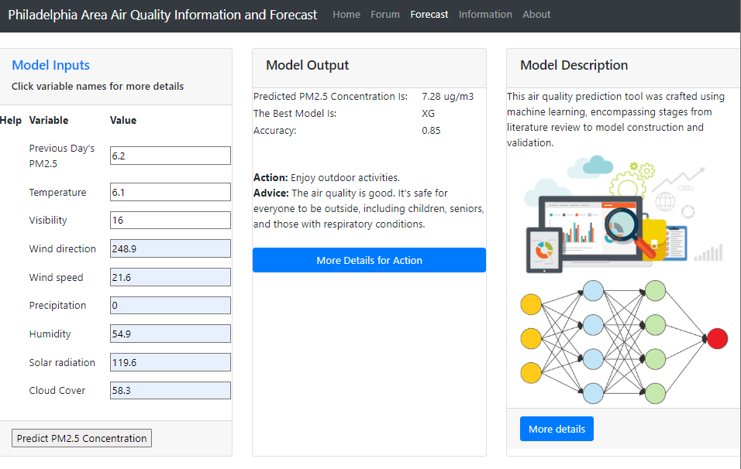
Procedure in place
Figure 1. Demonstration of Ensemble Model Run for Actual Days
The ensemble model was implemented primarily through my web interface at: philyair.com as shown in Fig. 1.
The ensemble model was run on January 11, 10:00 p.m, using the forecasted weather arguments for the following day (January 12th).
The best-performing model with the highest accuracy rate during this run, was the XG Boost machine learning model. The actual PM2.5 mean concentration for January 12th was 8.6 ug/m3, while the predicted value was 7.28 ug/m3.

Slide 10
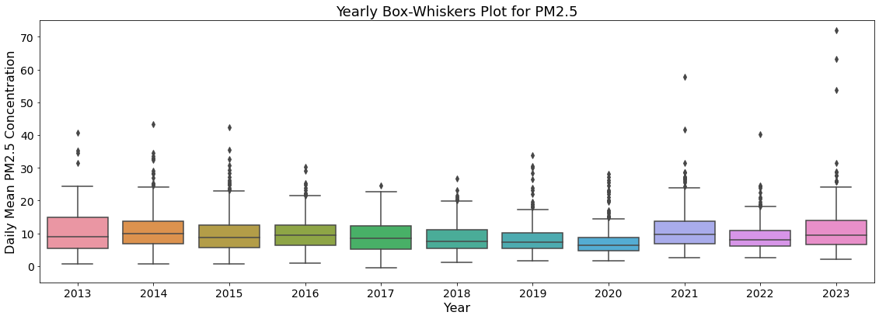
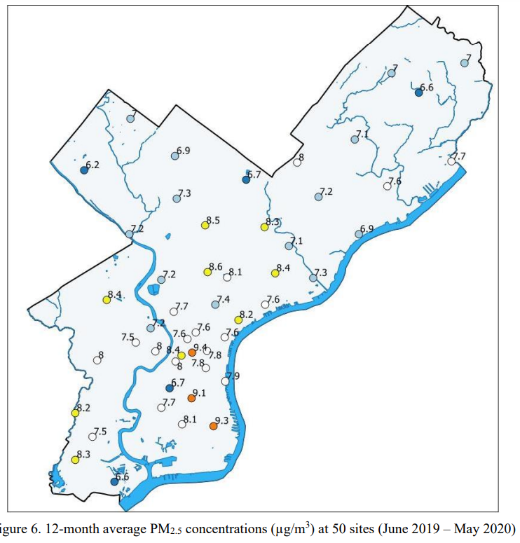
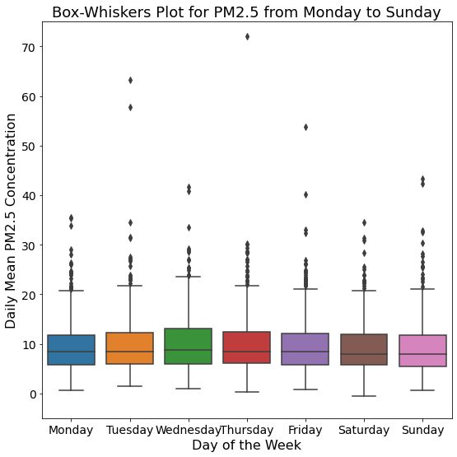
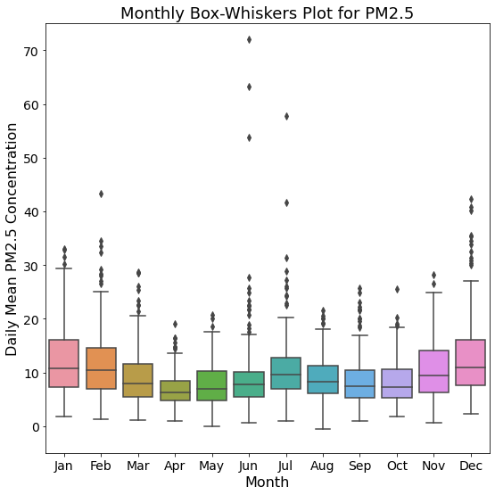
Data Collected
Source: https://www.phila.gov/media/20210316150355/PAQS_Report_Sept4-2020_final.pdf
PM_{2.5} at the “NEW” site from EPA air pollutants download site and NOAA weather data at Philadelphia Airport site were collected for the past ten years (Oct. 2013 to Jan. 2024.)

Slide 11
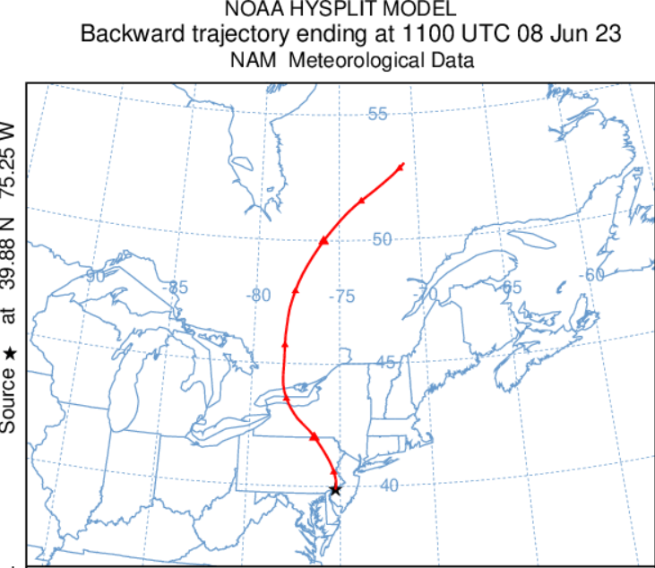
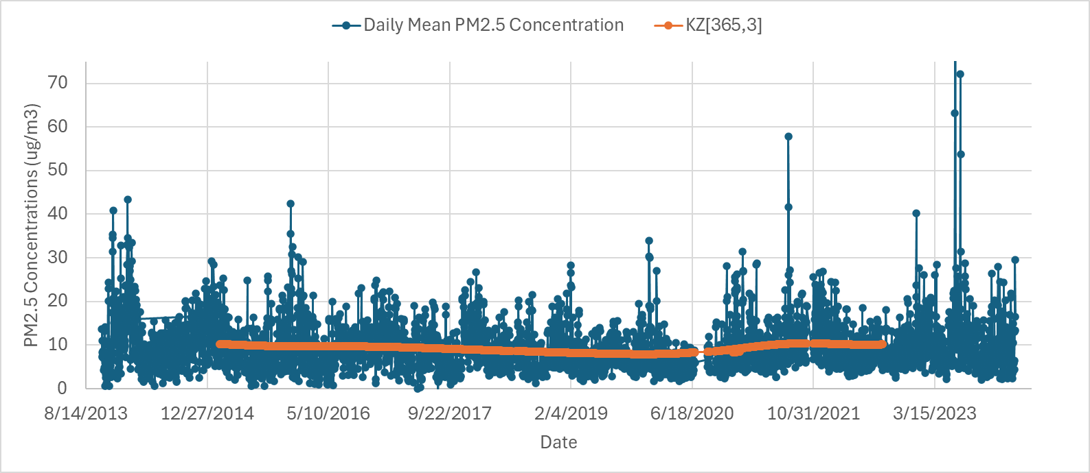
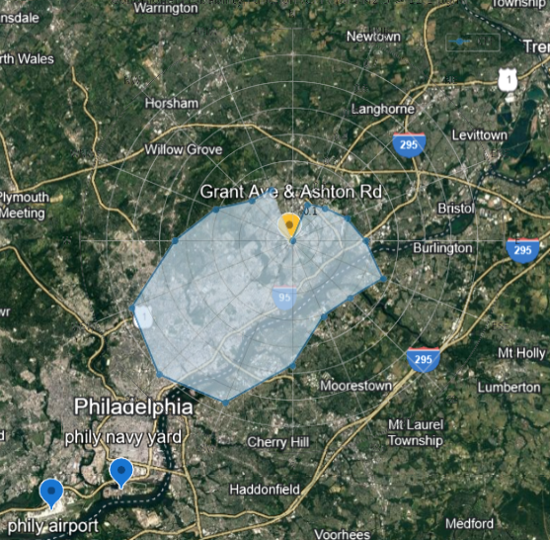
Results - Data Analysis
Canada Wildfire Event (211 ug/m3), Jun. 08, 2023
Reduction in PM2.5 Concentrations (2013 - Early 2020): From 2013 to early 2020, there was a significant decrease in PM2.5 concentrations, dropping from 10.26 µg/m³ to 7.75 µg/m³, marking an approximate reduction of about 30%. This decline reflects successful efforts in air quality management and pollution control measures during this period.
Recent Increase Due to Wildfires (Last 3 Years): In contrast, the last three years have witnessed a resurgence in PM2.5 levels, reaching up to 10.16 µg/m³. This increase is attributed primarily to a few days of exceptionally high PM2.5 concentrations, directly linked to long-range transport of smoke from Canadian wildfires. Notably, HYSPLIT4 48-hour back-trajectory modeling pinpointed that the elevated PM2.5 levels on June 8, 2023, were influenced by these wildfire events.
Local Impact from Industrial Activities: Analysis using the Conditional Probability Function, which assesses the frequency of wind directions in conjunction with PM2.5 levels exceeding 12.1 µg/m³, indicates that the NEW monitoring site's air quality is notably affected by industrial emissions originating from the southwest (SW) and south (S) directions. This finding highlights the localized influence of industrial activities on the site's PM2.5 concentrations.

Slide 12
Results - Ensemble Forecast Model (most common values)
Scenarios | RF | XGBoost | ANN
10 years | 89% | 85% | 79%
5 years all months | 96% | 92% | 80%
Winters | 94% | 90% | 91%
*The ensemble model was implemented primarily through my web interface at: philyair.com

Slide 13
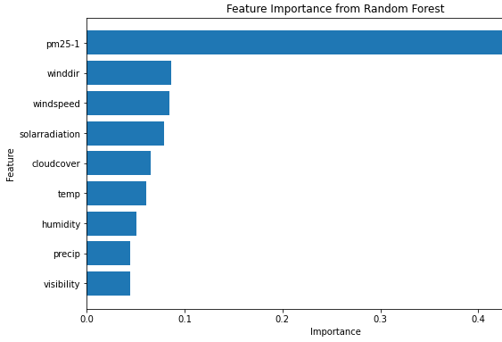
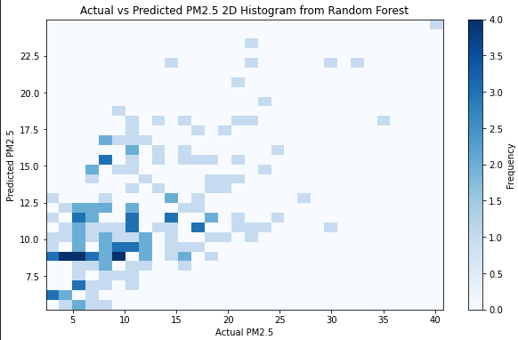
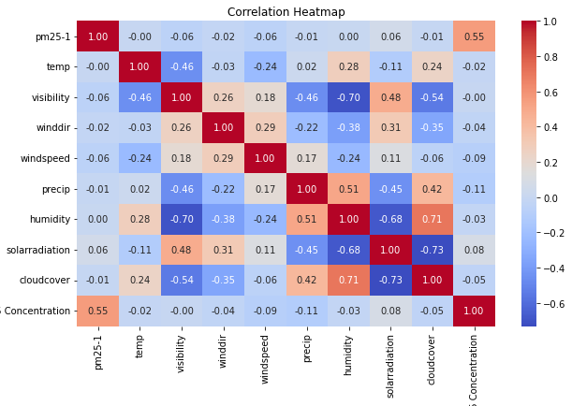
Results - Ensemble Model Forecast (Best performing model: Random Forest Model)
Scenarios | RF | XGBoost | ANN
10 years | 89% | 85% | 79%
5 years all months | 96% | 92% | 80%
Winters | 94% | 90% | 91%

Slide 14
Weaknesses/Improvements
Data Homogeneity and Automation: It's crucial to maintain data consistency in training datasets, addressing issues like time gaps and varying data types. Automating this process can minimize human errors and enhance efficiency, ensuring the data's reliability for model training.
Balanced Model Parameter Selection: When selecting model parameters, it's important to balance the trade-off between training and testing datasets. While a high percentage of data allocated for testing might improve model accuracy, it reduces the amount of data available for training. Early supervisory involvement can help in making informed decisions that adhere to physical principles and optimize model performance.
Improving Forecast Accuracy with AI: The accuracy of PM2.5 forecasts can be affected by biases in weather data from sources like NOAA. To mitigate this, employing AI-based weather forecasting tools, such as GraphCast, which offers higher accuracy, can significantly improve the reliability of PM2.5 predictions by providing a more accurate base for weather conditions.

Slide 15
Conclusion
Hypothesis 1:
It can be concluded that incorporating complex features, such as Philadelphia-specific air quality data and spatio-temporal analysis improves predictive accuracy because the model performs sensitivity analysis of PM2.5 to the various weather-related factors that are placed as input into the model, as it trains on the provided data.
The Random Forest model has proved to be the best-performing model in most cases, as it has provided the highest percentages for model accuracy in most cases.
Hypothesis 2:
The ensemble approach chooses the best-performing prediction model out of a selection of three. By quickly presenting the model with the highest accuracy rate, it spares time and resources by aggregating the prediction of each based model rather than running all three individually. Unseen data is cleanly handled and does not have to be directly handled by the end user.

Slide 16
Works Cited
Yang, Wei, and Igor Zurbenko. “Kolmogorov-Zurbenko Filters.” Wiley Interdisciplinary Reviews: Computational Statistics, vol. 2, no. 3, 6 Apr. 2010, pp. 340–351, https://doi.org/10.1002/wics.71. Accessed 12 Jan. 2024.
Balachandran, Sivaraman, et al. “Evaluation of Fire Weather Forecasts Using PM2.5 Sensitivity Analysis.” Atmospheric Environment, vol. 148, 1 Jan. 2017, pp. 128–138, www.sciencedirect.com/science/article/abs/pii/S1352231016307117, https://doi.org/10.1016/j.atmosenv.2016.09.010. Accessed 13 Feb. 2024.
Pope III, C. Arden, et al. "Lung cancer, cardiopulmonary mortality, and long-term exposure to fine particulate air pollution." Journal of the American Medical Association 287.9 (2002): 1132-1141.
Garcia, A., E. Santa-Helena, A. De Falco, J. de Paula Ribeiro, A. Gioda, and C. R. Gioda. "Toxicological Effects of Fine Particulate Matter (PM 2.5): Health Risks and Associated Systemic Injuries-Systematic Review." Water Air Soil Pollution, vol. 2023, 2023, doi:10.1007/s11270-023-06278-9.
Morapedi, T. D., and I. C. Obagbuwa. "Air Pollution Particulate Matter (PM2.5) Prediction in South African Cities Using Machine Learning Techniques." Frontiers. 2023.
Zaini, N., L. W. Ean, A. N. Ahmed, M. A. Malek, and M. F. Chow. "PM2.5 Forecasting for an Urban Area Based on Deep Learning and Decomposition Method." Scientific Reports, vol. 12, no. 17565, 2022. Nature Publishing Group.
Fan, K., and other authors. "Machine Learning-Based Ozone and PM2.5 Forecasting: Application to Multiple AQS Sites in the Pacific Northwest." Frontiers. 2023.
United States Environmental Protection Agency. "Air Quality Forecasting." Online Available: https://www.airnow.gov/?city=Philadelphia&state=PA&country=USA, Access 12/1/2023.
City of Philadelphia. "Air Quality Monitoring." Online Available: https://www.phila.gov/services/mental-physical-health/environmental-health-hazards/air-quality, Accessed 12/1/2023
NOAA National Climatic Data Center (NCDC). "Climate Data Online." Online Available: https://www.ncei.noaa.gov/cdo-web/, Accessed 12/1/2023
‌

